Slide 1
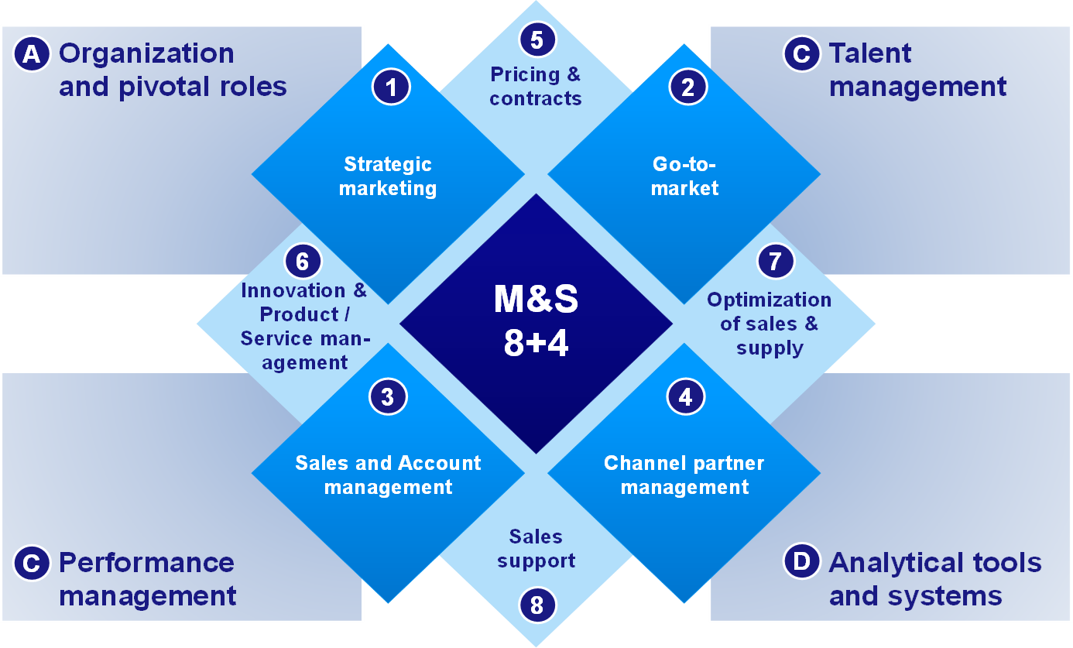
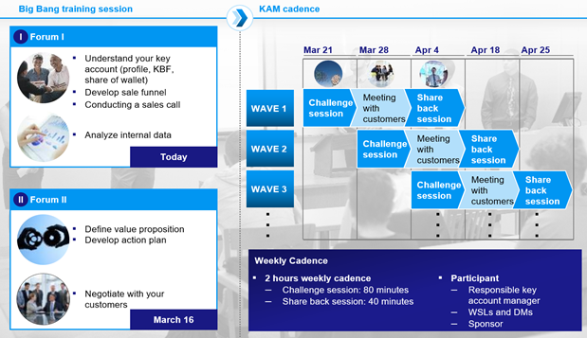
The first fully integrated petrochemical complex in Asia - we’ve been delivering steady impact for the past ~1.5 years, and exceeded 2017 target in Oct
Oil & Gas (GEM) | Asia-Pacific
O&G002
Situation
What we did
Impact
The first fully integrated petrochemical complex in Asia with over $70 Billion in sales across product lines
Two main commercial workstreams – petrochemical, and petroleum
In early 2017, petrochemical had a 518 mTHB gap to its 850 mTHB target, while petroleum had a 163 mTHB gap to its 700 mTHB target (bottom up targets)
We structured our capability program using the levers of the CCAT framework for commercial transformations
8+4 framework provided us the structure…
… to conduct deep capability building such as a Field & Forum exercise on KAM lasting for 16 weeks
Commercial work streams exceeded 2017 target in Oct
Target
Petroleum
1, 600 mTHB
Petchem
3
4
5
6
7
8
9
10
11
12
1
2
3
4
5
6
7
8
9
10
2016
2017
Expect both workstreams will deliver significant benefit to the program at the end of 2017
Total 1,718 mTHB
> 10% higher than bottom up target (gold target)

